Slide 1
Stochastic Optimization

Slide 2
Stochastic Optimization
Up to this point, we’ve focused on deterministic models
Deterministic models: we define all the input values
We realize that there is uncertainty, so we have run different what-ifs to
Find robust solutions
Determine the sensitivity of variables
But, we can directly model stochastic parameters
Stochastic optimization as term is broadly used
We are going to focus on recourse problems that can be formulated as LPs
Sources:
http://neos-guide.org/content/stochastic-linear-programming
http://people.brunel.ac.uk/~mastjjb/jeb/or/sp.html

Slide 3
Recourse: What is it?
You make a decision now that impacts future periods
Some random event happens and you soon learn how the future plays out
You can take some recourse action to adjust your plans for the new period

Slide 4
Let’s do an example: Natural Gas Company
Simple two year model
You are experiencing a normal winter this year
You don’t know what to expect next year
Normal– gas is relatively cheap
Cold – need more gas and it will be more expensive
Very Cold- need even more gas and it will be more expensive
You have different decisions
Buy now for just this year
Buy now for this year and buy and store product for future years

Slide 5
Example from Spreadsheet
Review data
Solve LP for different scenarios
Solve LP for the “average” scenario
Formulate and solve the LP as a stochastic linear program with recourse

Slide 6
Discussion Questions
How is the stochastic LP really like solving multiple models at the same time? What ties them together?
What would a 3-year gas model look like?

Slide 7
Recourse Problem Applications
Airline Ticket Prices
Finance
Modeling investment portfolio to meet uncertain liabilities
Insurance
Premiums come in and can be invested in assets with deterministic and stochastic returns
Claims come in randomly and can come in big waves
Recourse variables would be the liquidation (selling) of assets to meet claims
Goal would be a wise set of investments to meet obligations under various circumstances
Power systems
Meet varying amount of demand (heat waves)
Recourse variables could represent “peakers”
More expensive power generation that can easily be turned on or off
Capacity planning
Source: http://people.brunel.ac.uk/~mastjjb/jeb/or/sp.html

Slide 8
Why aren’t stochastic models used more in practice?
Hard to get probabilities
Hard to set up the models
Hard to understand the results (a single run can be hard enough to explain

Slide 9
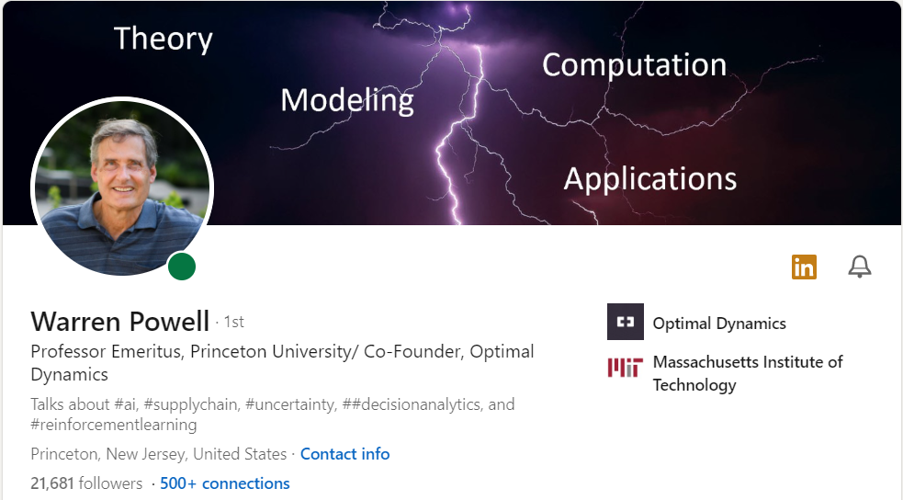
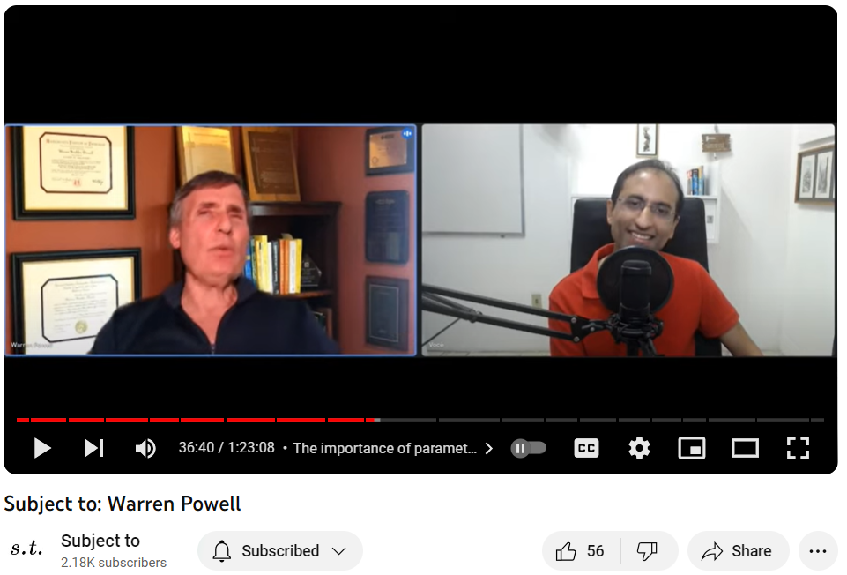
For more (more than I understand) on Stochastic Optimization
Claims that we should be studying Sequential Decision Problems

Slide 10
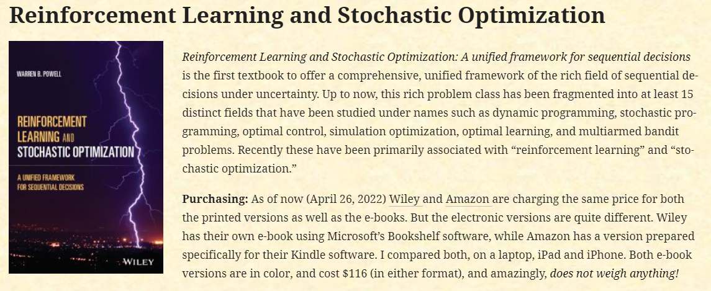
Claims all these problems are related

Slide 11
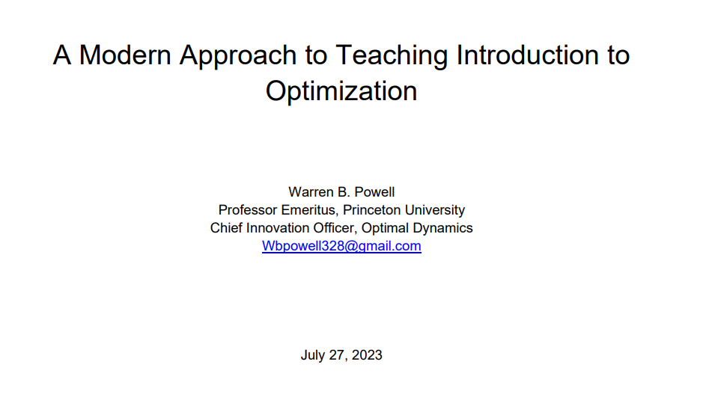
I was excited to read his book and bring it into this class
I need a year to study this to see what fits. (The problem could be me).
His approach: Sequential Decision Problems are everywhere. But, I found his material too technical.
What we want for this class: We want to teach you the power of modeling business problems. It might inspire us to write a book!

Slide 12
Some Key Ideas of Sequential Decision Problems: Five Components
State Variables (https://castle.princeton.edu/statevariables/)
Vector of physical and financial resources
Vector with other data (like prices
Vector with beliefs about quantities that aren’t known
Decision Variables
Information we learn over time
Transition function (how we from one state to another)
Objective function

Slide 13
Some Key Ideas of Sequential Decision Problems: Policies for Solving
Strategy I: Policy Search
Policy function approximations
Cost function approximations
Strategy II: Lookahead approximations
Value function approximations (Bellman’s equation)
Direct lookahead approximation
If this piques your interest, don’t let my lack of understanding prevent you from exploring this!!

Slide 14
End of Section

Slide 15
Intro Exercise

Slide 16
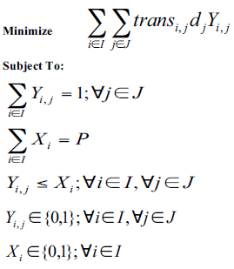
Our Simple Transportation Model (1)
Objective:
Minimize total transportation costs
trans_{i,j} is the cost to from i to j
Constraints
Meet all demand
Open just P warehouses or plants
If you use a site, you must use it
Decisions
Y_{i,j}– which customer is assigned to which plant or warehouse. Here we force this to be 0 or 1, meaning we single source the customer
X_{i}– which plant or warehouse is open
Question: What if we had another parameter: fixed_lane_{i,j} which is a fixed cost to open up a lane from i to j ? How would this change the model?
Answer: add another term to the objective function (+ Y_{i,j} fixed_lane_{i,j} ) Why does this work?

Slide 17
Question: What if we relax our Y_{i,j} variable so that is continuous between 0 and 1
Objective:
Minimize total transportation costs
trans_{i,j} is the cost to from i to j
Constraints
Meet all demand
Open just P warehouses or plants
If you use a site, you must use it
Decisions
Y_{i,j}– which customer is assigned to which plant or warehouse.
X_{i}– which plant or warehouse is open
0≤ Y_{i,j} ≤1
Questions: How do you interpret Y_{i,j}? How do you now model the fixed_lane_{i,j} fixed cost to open up a lane from i to j ? How would this change the model?
Answer: need another binary decision variable Z_{i,j} if you use the lane, add to objective (+ Z_{i,j} fixed_lane_{i,j} ), and force it to be used Z_{i,j} ≥ Y_{i,j}

Slide 18
Question: What if the Y_{i,j} variable is the flow from i to j? And, what if the warehouse had a simple capacity measure?
Objective:
Minimize total transportation costs
trans_{i,j} is the cost to from i to j
Constraints
Meet all demand
Open just P warehouses or plants
If you use a site, you must use it
Decisions
Y_{i,j}– which customer is assigned to which plant or warehouse and how much you send…
X_{i}– which plant or warehouse is open
Answer:
Objective doesn’t need to multiply by d_{j}.
Sum of Y_{i,j} equals demand
Need another binary decision variable Z_{i,j} if you use the lane, add to objective (+ Z_{i,j} fixed_lane_{i,j} )
Capacity constraint:, Σ_{i}Y_{i,j ;} ≤ capX_{i}
Force Z to be used correctly Y_{i,j} ≤ MZ_{i,j}
Force X to be used correctly Y_{i,j} ≤ MX_{i,}
Questions: How does the model change? How do you now model the fixed_lane_{i,j} fixed cost to open up a lane from i to j ? (Can you find all 6 changes?)

Slide 19
Big M Method

Slide 20
What is the Big M?
Powerful way to model logical IF-Then conditions when one variable is continuous
When both are binary, M = 1
When one is continuous, M = Big Number
Both binary: Y_{i,j} ≤ X_{i}
Y continuous: Y_{i,j} ≤ MX_{i}

Slide 21
What is the Big M?
Historically, it was a good practice to pick the BigM to be only as large as needed
Could cause numerical issues in linear programming model
http://orinanobworld.blogspot.com/2011/07/perils-of-big-m.html (numerical instability)
Bob Fourer’s (http://bob4er.blogspot.com/2013/02/the-big-m.html) article points out that commercial solvers may take care of the problem
CPLEX, Gurobi, and Xpress did not have any problems up to 19 9s
CPLEX had no problems up to 99 9s
These solvers tended to take care of the problem
Note: It can also be used to refer to the process of finding the first feasible solution in Simplex
It is good trick that comes up in many situations.

Slide 22

The Sam Hillis (MSiA Alpha Class) Trading Algorithm
Creating a financial trading algorithm
Uses deep learning techniques (we won’t cover this)
We needed to run an optimization problem to set the parameters
The optimization has a IF-THEN Statement in it
We had a Score and Threshold
We also need a Flag
The Flag is 1 or 0 if the Score is bigger than Threshold
The Flag must be 0 if the Score is less than the Threshold
Big M Constraint
(SCORE – THRESHOLD) + BigM * (1-FLAG) ≥ 0
If (Score – Threshold) is positive, then flag can be anything and we’ll be OK.
If (Score – Threshold) is negative, then flag has to be 0 so we can get an overall positive

Slide 23
End of Section

